Slide 1
Reduce, Reuse, and Recycle (3 Rs)
Oak Ridge Lavender Festival, June 20, 2026
Notes:
Welcome everyone. Thanks for participating in this learning session and coming out to enjoy the Lavender Festival.
UCOR is proud to be one of the Event Sponsors again this year supporting recycling initiatives.

Slide 2

Presentation Outline
Introductions
UCOR Mission & Scope
UCOR ‘Reduce, Reuse, and Recycle’ Programs
Discuss 3Rs
Recycling in our Communities
Special Waste and Hazardous Waste
What we can do to make a difference
Notes:
This learning session focuses on natural resource conservation and waste minimization through Reduce, Reuse, and Recycle.

Slide 3
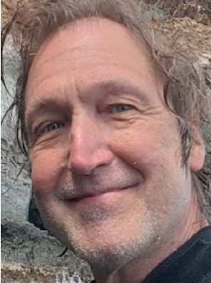
Introduction – Pat Mullen, UCOR
UCOR Environmental Management System and P2/WMin Coordinator
Leads UCOR’s programs for ‘Reduce, Reuse, and Recycle’
26 years supporting the U.S. Department of Energy (DOE) Oak Ridge Reservation (ORR) Environmental Management (EM)
20 years implementing programs
20 years environmental cleanup investigation, and assessment
Notes:
TELL STORY OF DIVING IN SOCORRO ISLANDS with dolphins, sharks, and manta rays; having a scientist onboard sponsored by the Mexican Government to collect oceanwater samples from around the islands that would be filtered to collect environmental DNA and analyzed to establish species diversity, fascinating advancements in science so we can better understand the world we are blessed to live in. One of the dives was requested by the Government to evaluate its suitability for bring other dive groups to the location and provide feedback on the diving quality and species diversity. My report noted the heavy covering of the rock and coral with algal growth that was killing the corals. Here we were in the middle of the pacific ocean away from almost all civilization if not for about 250 government-related inhabitants living on one island and you see what is happening all over the globe which is loss of our coral reefs. My only deduction was that that was the side of the island where wastewaters were being released as no where else did we see anything like that. The key takeaways from this story is as Humans, we have a profound impact on our environment, how we manage our wastes affects our environment, and what we do to minimize our waste and potentially harmful affects of our practices can have a profound impact on our environment, and hopefully we are implementing practices to minimize of environmental impacts.

Slide 4
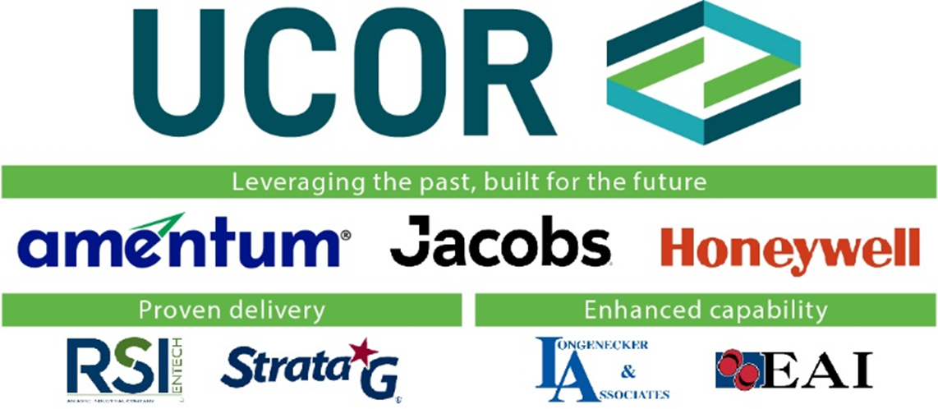
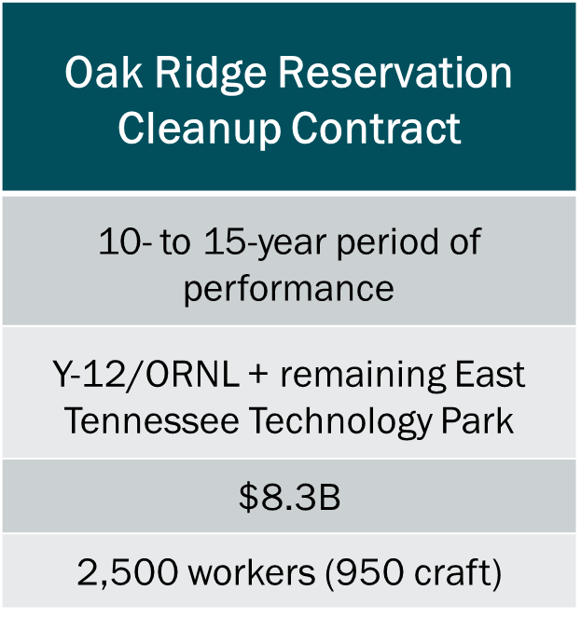
Oak Ridge Reservation Environmental Cleanup
PAGE 4
Notes:
The DOE and UCOR partner to provide ORR EM services at the East TN Technology Park (former K-25 site), Oak Ridge National Laboratory and Y-12 National Security Complex

Slide 5

UCOR Work Scope
UCOR is the prime environmental cleanup contractor on the Oak Ridge Reservation
Work Scope
Decommissioning, deactivation, and demolition of facilities and structures
Cleanup of contaminated soil and groundwater
Waste disposition and management
Reindustrialization and conservation of federal land
Notes:
UCOR incorporates sound environmental management, protection, and stewardship considerations in our business decisions, work processes, and activities.

Slide 6
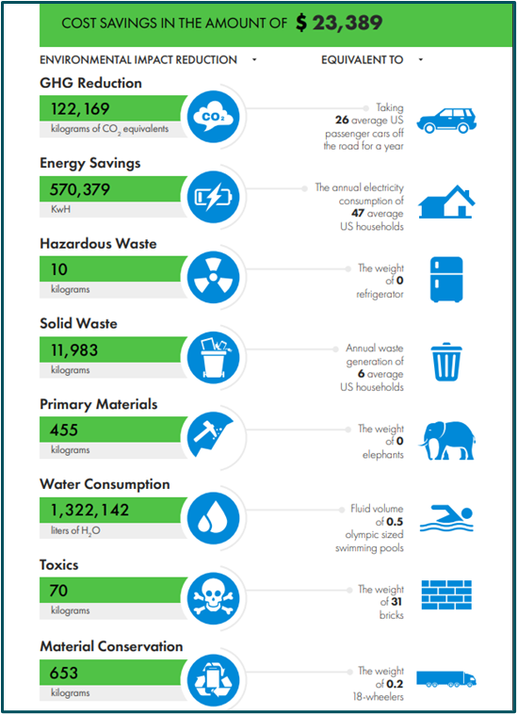
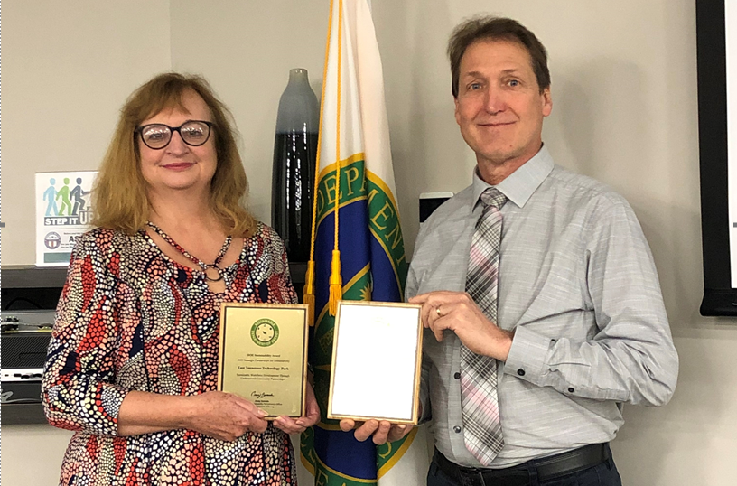
Leading Environmental Stewardship
Global Electronic Council Electronic
Product Environmental Assessment
Tool (EPEAT) Awards
EPA Federal Green Challenge Award
GreenBuy and Green Fleet Awards
DOE HQ Sustainability Awards
Notes:
If was an honor to get to go to Washing DC on behalf of UCOR to receive two DOE Sustainability Awards for water resource conservation and environmental justice (local community benefits).

Slide 7

Strong Environmental Partnerships
Supports STEM locally (community and K-12 programs) and local college and university programs
Supports numerous local community initiatives
  Lavendar Festival (recycling)
  Public Information Meetings
  Rails to Trails Conservancy
  (greenways)
  Clinch Valley Trail Alliance
  Haw Ridge Park – The Dirt Lab
  Coats for Cold/Roane State Career Closet
  Oak Ridge Natural Assets Plan
  Public Kayak Access Grant

Slide 8
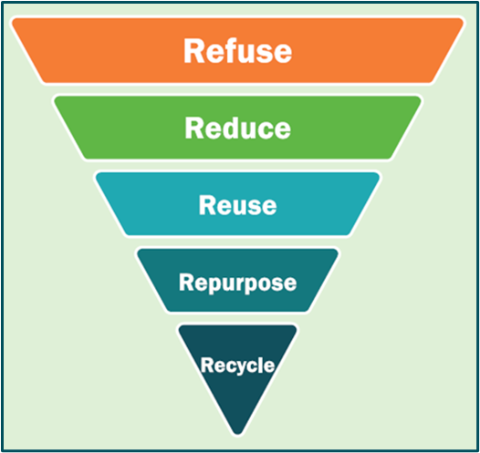
Waste Diversion at UCOR
‘Furniture Re-Store’
Tire cutting machine
Pallet reuse
Drum crusher
Soil and wood chip reuse
Broad recycling initiatives including
  Paper products, toner cartridges, computers/electronics
  Scrap metals, aluminum, aerosol cans
  Tires, antifreeze, used oil, lead-acid batteries,
  Much more
Notes:
Most of these recycling initiatives that UCOR implements can and should be implemented by businesses and households!
Refuse or substitute is the most effective in beneficial in eliminate detriments to the environment; Recycling is great but the other alternatives if available should be implemented where practical or possible.

Slide 9
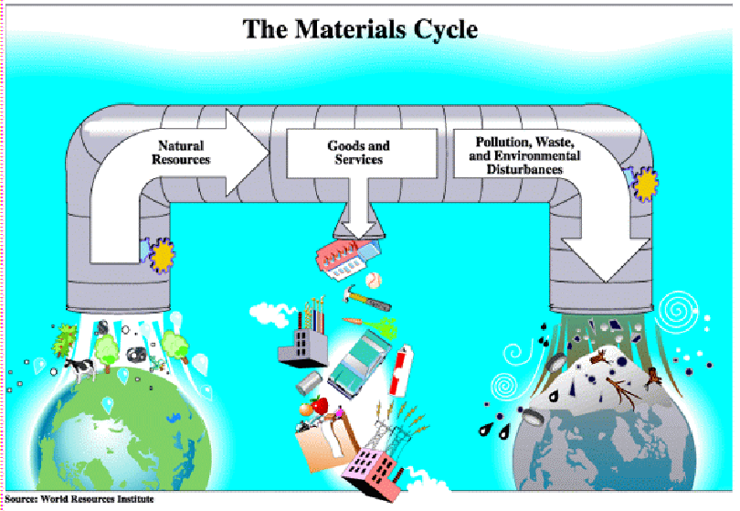
Environmentally Preferrable Purchasing (EPP)
EPP: purchasing environmentally friendly products & services
  What can we do to reduce our impacts on the environment?
Notes:
Almost everything we do has an impact on our environment and what we do to improve our practices can make a huge difference
Encourage the purchase of less toxic, biobased products and recycled/recovered content materials and products.
Choose less environmentally harmful products over other non‑bio‑preferable products that serve the same purpose.
We all should endeavor to implement resource conservation, pollution prevention, and waste minimization practices when and where we can!

Slide 10
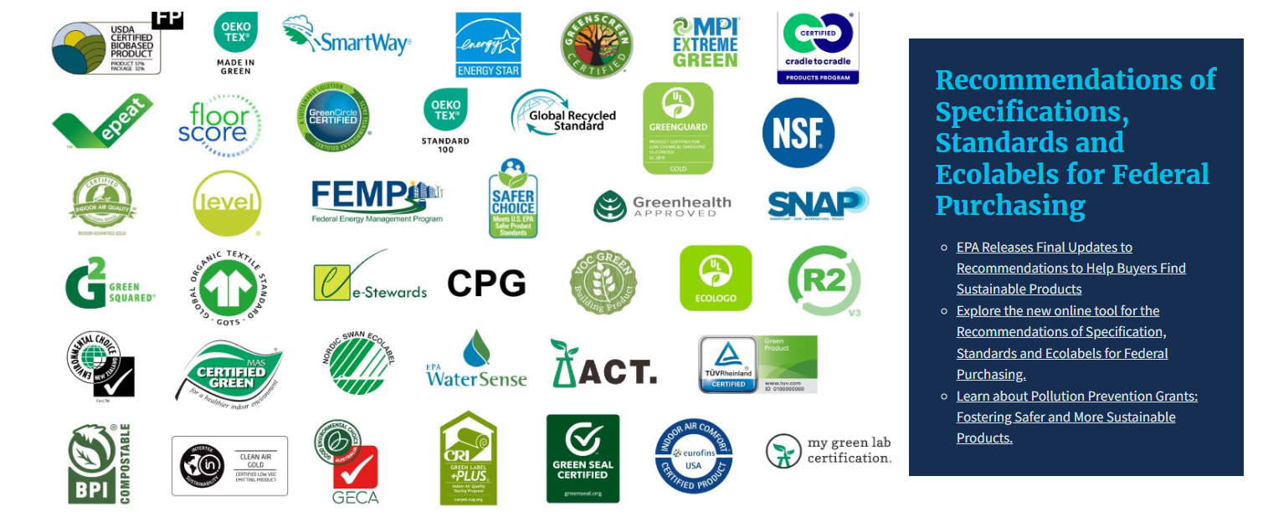
Sustainable Marketplace: Greener Products & Services
Notes:
Hopefully you are familiar with some of these.
These are all logos for programs or initiatives that promote resource conservation and reduce environmental impacts from the products and services we buy.
Most of the programs have websites where we can access to fine information to become more knowledgeable and eco-friendly consumers.

Slide 11
Common Recycling Myths
Most people recycle all they can
Recycling arrows on a container mean it is definitely recyclable
Containers must be squeaky clean in order to be recycled
Even if an item shouldn’t go in the bin, it will get sorted anyway
Hoses, tanks shower curtains, swing sets, etc., are recyclable
All types of glass bottles and jars are recyclable
Notes:
Let’s get a little interaction going and test your understanding of what we know about recycling. [Source Waste Management Recycling 101]
Answer key is provided as the last slide.
FALSE: Research shows convenience and commitment are required to maximum recycling
REALITY: only in some cases. This takes some learning (we will cover this later in this presentation) but predominantly we recycle Type 1 and Type 2.
REALITY: Containers should be clean, but do not have to be spotless.
FALSE: Non-recyclable items are not accepted curbside and they can contaminate the recyclables. Recyclables with the greatest impact are plastic bottles, cans, paper, and cardboard.
REALITY: If its not plastic bottles, cans, paper, or cardboard, it probably does not belong in your curbside recycling. Seel other alternatives.
Most recycling facilities no longer process glass.

Slide 12

The Three R’s: Order Matters!
1. Reduce: Stop waste before it starts
(most impactful)^{[1]}
2. Reuse: Give items a second life(highly sustainable)^{[1]}
3. Recycle: Reclaim materials to make new products (last resort)^{[2]}
Why local action matters:
  Curbs landfill expansion
  Protects East Tennessee wildlife and local waterways
  Saves taxpayer dollars on waste management^{[2]}
  Reduces risks from transporting waste across the country
Notes:
Disclaimer: I used Artificial Intelligence (AI) to generate some of the content for this presentation so, no promises that all information is entirely accurate.
"We often hear 'Reduce, Reuse, Recycle' said all as one word, but they are actually listed in order of importance! Recycling is fantastic, but it requires energy and transportation. The absolute best thing we can do is to first reduce the amount of trash we bring into our homes, and then reuse what we can. Let's look at how we can apply these three steps right here in our neighborhoods.“
Sometimes the 3 Rs can be integrated, take for example the journey of a plastic water bottle. First use can be a waste or consider that we drink the water, then we refill it; eventually recycle it instead of disposing as waste so it can get mettled down and reused.
If you travel or venture out into your communities or your places of business, be aware of how potential waste is being managed. Or when at airports or in other Cities, States, and Countries, observe how or if the 3 Rs are being applied. Observe, Learn, Adopt, and Advocate principles that can have a positive impact on our communities.

Slide 13
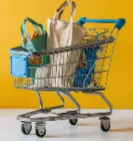
Step 1 – Reduce (Smart Shopping)
Shop with intent:
  Swap single-use plastic bags for reusable tote bags
  Buy in bulk to avoid excess plastic packaging^{[1][3]}
Ditch the disposables:
  Use refillable water bottles and coffee mugs (perfect for local greenways!)
  Say "no thanks" to plastic silverware and straws with takeout food
Avoid food waste:
  Meal plan using local ingredients from the Market Square, Oak Ridge, local Farmers Markets, and your own yard
Notes:
"Reducing starts at the grocery store. When you shop at Food City, Kroger, Publix or our wonderful local farmers markets, bring your own bags. Simply choosing products with less packaging makes a massive difference. Think about this: if every resident in the County you live in used just one less plastic water bottle a week, we could keep millions of bottles out of our local waste stream every single year.“
[Oak Ridge Farmer’s Market 281 Broadway Avenue, 8 am to noon]
[1001 Ebenezer Rd, Knoxville Tuesdays 3 to 6 pm]
[Market Square Wed. 10 to 1; Sat. 9 to 1 pm]
[Dixie Lee Farmer’s Market, Farragut 9 am to noon]

Slide 14

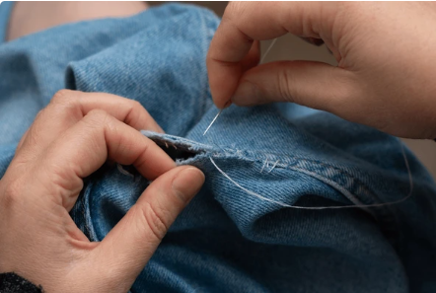
Step 2 – Reuse (Upcycling & Giving Back)
Donate & shop locally:
  Clear out closets and donate to
  local organizations
Repair Over Replace:
Fix clothing, furniture, and
electronics instead of
throwing them away
  Get Creative at Home:
Glass jars make excellent
food storage or planters.
Repurpose old t-shirts into cleaning rags
Notes:
"Before throwing something away, ask: 'Can someone else use this?' or 'Can I use this differently?' We have incredible local networks like KARM and Goodwill that make donating easy.^{[1][2]} Upcycling is also a fun way to save money. Have a garage sale or you can sell your stuff on Facebook Marketplace or XXX. Old glass pasta sauce jars make excellent storage for dry goods, and those old cotton t-shirts can easily replace paper towels for household cleaning.“

Slide 15
Step 3 – RECYCLE (The Golden Rules of Recycling)
Keep it Clean and Dry: Rinse containers!
Keep it LOOSE: Never bag your recyclables.
Know Your Local Rules: What is recyclable in Knoxville might not be in Clinton or Oak Ridge
When in Doubt, Throw It Out: "Wish-cycling" does more harm than good!
Notes:
"Now let's talk about Recycling. There are three golden rules:
Keep it clean, keep it dry, and keep it loose!
One of the biggest mistakes people make is putting their recycling inside a plastic garbage bag.^{[4][5]} When those bags arrive at the sorting facility, workers often have to throw the entire bag into the trash because they don't have time to tear them open,^{[4][3]} and plastic bags tangle up the sorting gears.^{[1][5]}
Always dump your recyclables loose into the collection bins.“

Slide 16
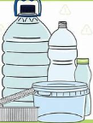
7 Types of Plastics
Type identified by numbers in recycling triangle
Type 1: PET or PETE (Polyethylene Terephthalate)
  Uses: Drink bottles, food containers, packaging trays
  Recyclability: Widely recyclable. Repeated use can increase chemical leaching and bacterial growth
Type 2: HDPE (High-Density Polyethylene)
  Uses: Milk jugs, detergent bottles,
  shampoo containers
  Recyclability: Highly recyclable,
  considered safe for food contact
Notes:
The number inside the triangle is a Resin Identification Code (RIC), indicating the type of plastic, not necessarily its recyclability
Plastics #1 (PET) and #2 (HDPE) are the most commonly accepted for recycling.

Slide 17
Types of Plastics with limited recycling
  Type 3: PVC (Polyvinyl Chloride):
  Uses: Pipes, clear food packaging, shrink wrap
  Recyclability: Separate from PET/PE streams; limited due to additives
Type 4: LDPE (Low-Density Polyethylene)
  Uses: Grocery/bread bags, shrink wrap, squeezable bottles
Type 5: PP (Polypropylene)
  Uses: Yogurt cups, butter tubs, microwavable trays, automotive parts
Type 6: PS (Polystyrene)
  Uses: Disposable cups, plates, cutlery, packaging foam
Type 7: Other Plastics
  Uses: Polycarbonate, bioplastics, multi-layer packaging
Notes:
Key Points
Plastics #3–#6 are more challenging to recycle, and #7 is a catch-all category that is rarely recyclable.
Understanding these codes helps in safe usage, proper recycling, and reducing environmental impact.
By recognizing these types, consumers can make informed choices about reuse, disposal, and recycling of plastic products.

Slide 18
Recycling in Anderson County & Oak Ridge
Anderson County Convenience Centers:
  Glen Alpine, Wolf Valley, Green Valley, Marlow, Frost Bottom, and Blockhouse Valley Road.
  Single-Stream compactors make dropping off easy.
Accepted Materials:
  Corrugated cardboard, aluminum & steel cans, mixed paper, and mixed plastics #1–7.
No Glass Recycling:
  Glass currently not accepted in most local convenience centers.
Oak Ridge Residents:
  Backdoor/curbside collection of recyclables or drop-off at the Warehouse Road Convenience Center (Oak Ridge residents only).
Notes:
"Now, looking at our Anderson County neighbors! Anderson County operates several convenience centers, including Glen Alpine, Wolf Valley, and Green Valley,^{[3]} which feature single-stream compactors.^{[3]} This means you can mix your paper, cardboard, metal cans, and plastic containers #1–7 together.^{[3]} However, please note that glass is not currently accepted for recycling in Anderson County. Because of regional market shifts and sorting safety concerns,^{[3]} glass must go in the regular trash here,^{[2]} or you can save it for a trip into Knox County's drop-off centers.^{[7][9]} For Oak Ridge residents, you have local curbside service or access to the Warehouse Road center.“

Slide 19
Recycling in Knox County
City of Knoxville Curbside (Opt-in):
  For residents with 1–4 dwelling units.
  Accepts paper, cardboard, metal cans, and plastic containers #1–7 (No Styrofoam).
Knox County Convenience Centers:
  7 centers for county residents (Halls, Karns, Powell, Dutchtown, etc.).
The Glass Rule:
  Glass is NOT accepted in curbside bins or County Convenience Centers.
  Glass must go to the 4 City Drop-Off Centers (e.g., Cedar Bluff, Pleasant Ridge) or the UT Campus Center.
Notes:
"For our Knox County residents, where you live dictates how you recycle.^{[6]} If you are in the City limits, you can opt-in to curbside recycling.^{[1][6]} If you are in the County (like Powell, Halls, or Farragut), you can take your recycling to one of the 7 County Convenience Centers.^{[5]} Here is a very important local tip: Glass does not go in curbside bins or County centers. Curbside glass breaks and ruins the paper and cardboard. If you want to recycle glass, please bring it to one of the four City of Knoxville Drop-Off Centers, like the ones at Cedar Bluff or Pleasant Ridge.“

Slide 20
The "No-List" (What NOT to Recycle)
Plastic grocery bags: Take these back to store drop-off bins at Kroger, Food City, or Publix.
Styrofoam: Egg cartons, cups, and packaging belong in the trash (except clean foam trays, which can go to Publix drop-offs).
Food-Soiled Paper: Greasy pizza boxes or used paper plates must go in the trash.
Hoses, Wires, and Light Strings: These "tanglers" shut down sorting facilities and damage machines.
Notes:
"Let’s bust some common recycling myths. Just because an item has a triangle on it doesn't mean it goes in your recycling bin.^{[4][3]} Grocery bags, bubble wrap, and plastic wrap cannot go in your household bins—but you can drop them off at grocery stores like Food City, Kroger, or Publix.^{[1][3]} Also, grease ruins paper recycling. A clean cardboard box is great, but a greasy pizza box is trash.^{[4]} When we keep these contaminants out of our bins, our local recycling system runs smoothly and efficiently.“

Slide 21
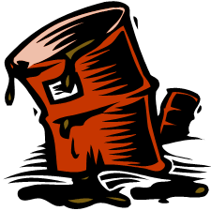

Special Waste & Hazardous Materials
Household Hazardous Waste (HHW):
Knox: Bring chemicals, pesticides, & oil-based paint to the SWMF/HHW Facility at 1033 Elm Street
Anderson: Watch for annual/bi-annual HHW collection events.
Latex Paint Tip: Oil-based paint is hazardous. Latex (water-based) paint is not! Dry it out with cat litter or sawdust, then throw it in your regular trash.[
Electronics (E-Waste):
Knox: Accepted at Dutchtown, Halls, John
Sevier, and Karns centers.
Anderson: Check local electronics recycling vendors or county collection events.
Notes:
Household Hazardous Waste (HHW) is any unwanted or spent household product that can easily catch fire (flammable), eat away at or irritate living tissue (corrosive), react violently with water or other chemicals (reactive), or be poisonous to humans and animals (toxic). Usable household products may exhibit hazardous properties, but until they become waste, they are not appropriate for the mobile household hazardous waste program. Before attending a mobile collection event, please review the lists below of acceptable and unacceptable items.
"Some items require special handling.^{[4][7][10]} Electronics, chemicals, batteries, and oil-based paint should never go in your trash or standard recycling bins.^{[1][2]} Knox County has a permanent Household Hazardous Waste facility on Elm Street, while Anderson County hosts designated HHW collection days.^{[7][10]} Here is a great pro-tip: If you have leftover latex paint (water-based), it isn't actually hazardous! You can mix it with cheap kitty litter or sawdust until it solidifies, and then safely throw it in your regular household trash.“
I believe the next Collection Event in Oak Ridge at the Public Works Department, 100 Woodbury Lane is September 19, 2026

Slide 22
Let’s Keep East Tennessee Beautiful!
Get involved locally:
  Keep Knoxville Beautiful: Volunteer for neighborhood cleanups, school programs, and beautification events.
  Join local road cleanups and help protect our scenic watersheds.
  Spread the Word: Share what you learned today with neighbors, family, and co-workers
Contact & Resources:
  City of Knoxville: Knoxvilletn.gov/wasteandresources
  Knox County Solid Waste: KnoxCounty.org
  Anderson County Solid Waste: LitterFreeInTennessee.org
  Earth911 - More Ideas, Less Waste
Notes:
^{[3]} > "Individual actions add up to a massive collective impact. By making small changes in how we reduce, reuse, and recycle, we can keep Knox and Anderson counties beautiful, healthy, and pristine.^{[7]} I encourage everyone to check out Keep Knoxville Beautiful or Keep Anderson County Beautiful to volunteer for a local cleanup or educational event. Thank you all so much for your time today! Let's protect our East Tennessee home together.“

Slide 23
Key Takeaways
Be a conscientious consumer of goods and services.
Use products with recycled or bio-preferable content.
Minimize environmental impacts where practicable.
Know applicable regulations regarding the 3 Rs.
Keep Household Hazardous Waste out of the landfills.
Implement best management practices at home and at work.
Continue learning and striving to improve.
Be a community partner in keeping TN beautiful!
Notes:
Questions or comments?
Please see me for more information, resources, or to discuss topics covered in this presentation afterwards

Slide 24
THANK YOU for participating in Reduce, Reuse, and Recycle!

Slide 25
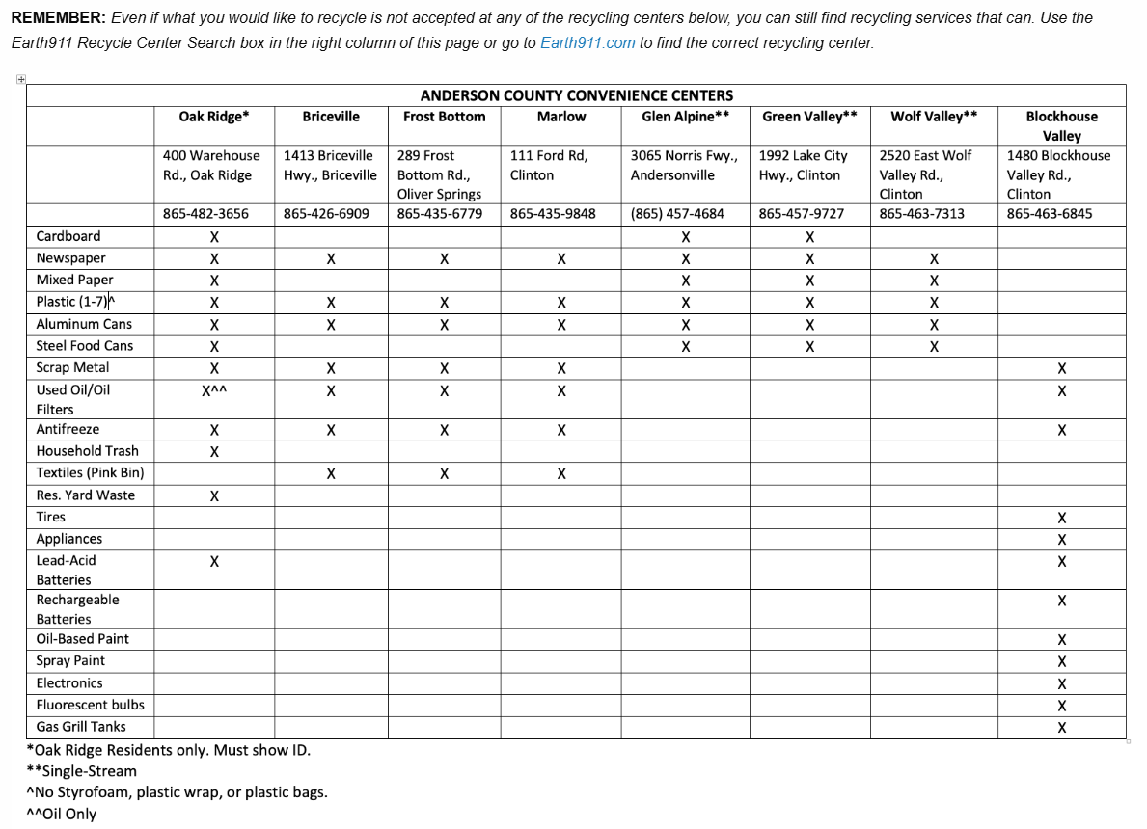
Local Guide to Reduce, Reuse, and Recycle

Slide 26
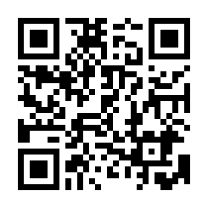
To download the presentation

